Slide 1
AML Tuesday’s Session #8 on:
Enhanced Due Diligence (incl. Risks Associated with PEPs)
28 March 2023

Slide 2
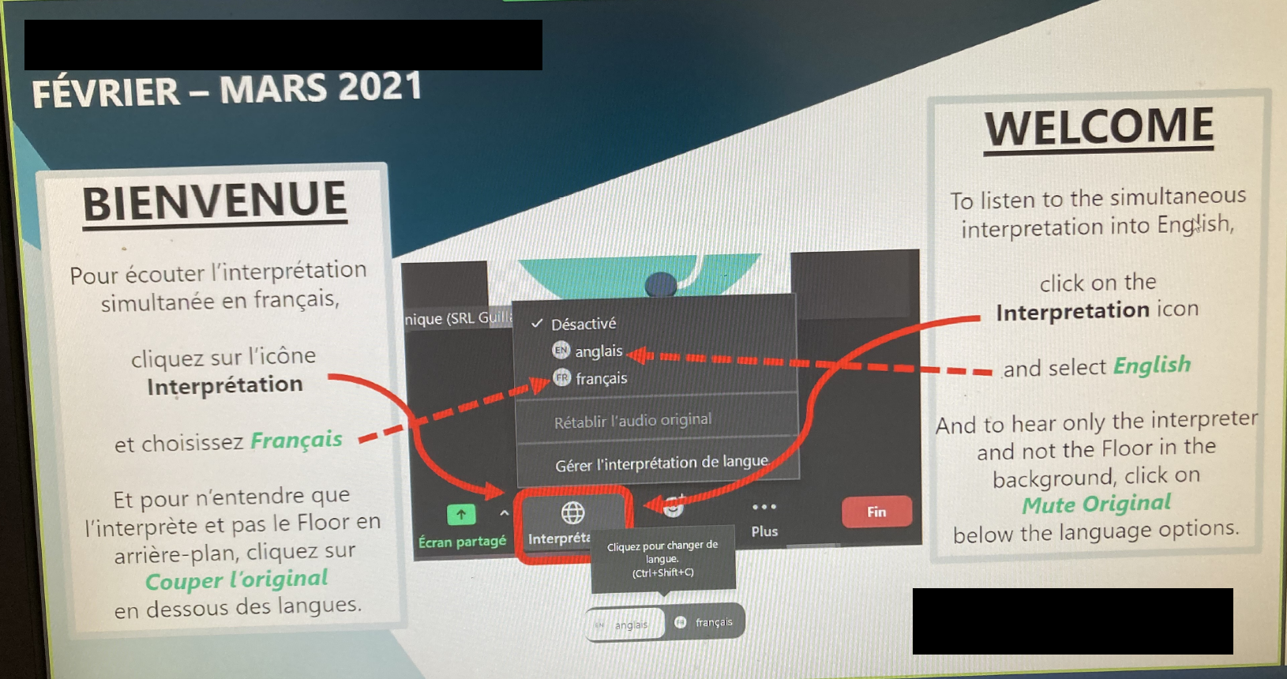

Slide 3
Agenda
10:00 – 10:05 | Welcome and Opening
10:05 – 10:15 | FATF Recommendation 10 and Monegasque Law
10:15 – 10:50 | EDD Measures
10:50 – 10:55 | Conclusion
10:55 – 11:00 | Questions & Answers

Slide 4
FATF Recommendation 10 and Monegasque Law

Slide 5
FATF Recommendation 10 – Customer Due Diligence
CDD – Customer Due Diligence
1
Identify and verify the Customer’s Identity – including BO
Understand and obtain information on the purpose and intended nature
Conduct ongoing Due Diligence on the Business Relationship
EDD – Enhanced Due Diligence
2
Conduct enhanced CDD measures consistent with the risks identified
SDD – Simplified Due Diligence
3
Verify the Identity of the customer and the beneficial owner after the establishment of the business relationship

Slide 6
FATF Recommendation 10 – Customer Risk
CUSTOMER RISK FACTORS
Politically Exposed Person
Non-Resident Customer
Cash-incentive Business
Customer Risk Assessment
GEOGRAPHIC RISK
Countries Subject to Sanctions
Countries not having adequate AML/CFT Systems
LOW
STANDARD
HIGH RISK
PRODUCT/SERVICE RISK
Private Banking
Anonymous transactions involving cash
Simplified DD
Standard
DD
CDD
EDD
DELIVERY CHANNEL RISK
Non-Face-to-face business relationships

Slide 7
FATF Recommendation 10 – Customer Due Diligence
EDD measures are not a substitute for CDD measures - must be applied in addition to CDD measures
EDD measures must always be commensurate with the ML/TF risks identified
EDD must be applied in certain situations as provided for in AML/CFT Law and Instructions but also where an FI has assessed that the risk of ML or TF is higher
EDD should be applied if there are doubts about the accuracy of the customer’s ML/TF risk classification

Slide 8
Requirements under Monaco Law (Articles 3-5)
DNFBP’s shall apply appropriate measures which are proportionate to the nature and size of the risk. For this purpose, they shall conduct the customer risk assessment
CDD applies when:
Undertaking occasional transactions of Fund transfer/Cash transactions above the defined threshold (including split transactions)
There is a suspicion of ML regardless of the threshold
Entering a business relationship
CDD includes:
Identification of the customer, agent, and beneficial owner
Checking the identification document
Verification of the address
Collection of proportionate information on the purpose and nature of the business relationship.
EDD
Regularity of the business relationship, aim and purpose, nature, and expected volume of transactions
Collection of information on SoF/SoW – reliable documents

Slide 9
Requirements under Monaco Law - EDD
PEP
Complex transaction;
transaction of an abnormally high amount;
Transaction is carried out with an unusual scheme;
Transaction with no apparent economic or lawful purpose;
High-risk Jurisdictions
Correspondent Relationships
Identification has been carried out remotely

Slide 10
EDD Measures

Slide 11
Enhanced Due Diligence Measures
Obtain additional information on the customer
Occupation
Volume of Assets
Background check
Obtain information on the Source of Funds
and Source of Wealth
EDD
Obtain additional information on the activity
Additional information on the
intended nature of the business relationship
The reasons for intended or
performed transactions
Take additional measures
Obtain senior management approval
Conduct Enhanced Monitoring
Require the first payment to be carried
Through account with an FI subject to
Similar CDD standards

Slide 12
Enhanced Due Diligence Measures (cont’d)
When carrying out such EDD measures (especially as regards acquiring and investigating more information about the nature of the customer’s business, purpose of the Business Relationship, or reason for the transaction), FIs should:
Pay particular attention to the reasonableness of the information obtained
Evaluate it for possible inconsistencies and for potentially unusual or suspicious circumstances.

Slide 13
Requirements for PEPs
Requirements Under Monegasque law
Risk Management system to determine if PEP (including if an existing customer becomes a PEP)
Obtain senior management approval before establishing or continuing a business relationship
Take reasonable measures to determine the source of wealth and source of funds
Conduct enhanced ongoing monitoring of the business relationship

Slide 14
Requirements for PEPs (cont’d)
FIs should have policies and procedures in place setting out:
The reporting and escalation of PEP relationships to senior management
Timelines for obtaining senior management sign-off
The level of seniority required to approve a PEP relationship
When considering whether to approve a PEP Relationship FIs should consider:
Level of ML/TF risk exposure
Resources required to mitigate the risk effectively

Slide 15
Requirements for High-Risk Jurisdictions – Art. 14-1
DNFBP’s are required to examine all transactions and business relations with customers from countries whose anti-money laundering, terrorist financing or corruption mechanisms present strategic deficiencies that pose a significant threat to the proper functioning of the financial system. The list of such jurisdictions are published by SICCFIN
DNFBP’s are obliged to apply risk-based and enhanced due diligence measures that are effective and proportionate to the risks involved

Slide 16
Requirements for High-Risk Jurisdictions – Art. 14-1 (cont’d)
Example of measures to take
Increased scrutiny and higher standards of verification and documentation from reliable and independent sources
More detailed inquiry and Evaluation of Customer
Increased investigation to ascertain whether the customers or related persons are foreign PEPs
Increased supervision of the Business Relationship

Slide 17
Requirements for Complex & Unusual Transactions
EDD measures must be applied which are consistent with the risks identified
Such measures must include:
Increasing the degree of nature of monitoring of the business relationship and related transactions to determine if these transactions give rise to suspicion

Slide 18
Requirements for complex and unusual transactions
Examples may include, transactions or patterns of transactions that are:
Larger than what is normally expected based on the knowledge of the customer, business relationship or risk category of the customer
Unusual or unexpected compared with the customer’s normal activity or that associated with similar customers, products or services
Complex compared with other similar transactions associated with similar customer types, products or services and the DNFBP is not aware of an economic rationale or lawful purpose or had doubts about the veracity of the information given

Slide 19
Requirements for non-face-to-face identification
Additional measures which should be taken may include:
Requesting certification of documents
Requesting additional documents
Applying additional verification measures
Requiring first payment for the product/service to be drawn on an account in the customer’s name at a supervised bank.
Applying other safeguards such as certified remote electronic identification schemes.

Slide 20
Source of Funds & Source of Wealth
Source of Funds v. Source of Wealth
What Constitutes “Reasonable Measures”
Reliance on Customer information v. obtaining independent sources of evidence
Contracts of sale, property deed
Report for authorized professional subject to ML/FT supervision
Information from a reliable public or private third-party source
Information from financial statements that have been prepared and audited in accordance with generally accepted accounting principles

Slide 21
Additional Documents
Documents issued by a government Authority or a court
Documents issued by other public sector bodies or local authorities
Documents issued by businesses regulated by the Financial Services Authority or overseas equivalent
Documents issued by professionals regulated for anti-money laundering purposes by the bodies

Slide 22
EDD and its Role in Customer Acceptance
Deny on-boarding
Increase the risk rating of the customer
Place thresholds on customer activity/transactions/products
Subject the customer’s transactional activity to heightened monitoring
Terminate the customer relationship

Slide 23
Other Higher Risk Situations
Business relationship conducted in unusual circumstances
Ownership structure of company appears unusual or excessively complex given the nature of the companies business
High Net Worth Customers and/or beneficiaries whose source of income is unclear
Non-resident customers and beneficiaries
Personal Asset Management vehicle
Cash intensive businesses or activities
Private Banking
Customer’s request to change or increase sum insures/premium payment are unusual or excessive
Unusually complex trading schemes
Transactions which are structured to transfer value from one party to another
Transactions or documents involving accounts in multiple jurisdictions

Slide 24
EDD Internal Process
Internal Controls
Internal Policies
Customer Registration
Transaction Monitoring
Screening
Controlling Thresholds or other limitations
Risk Management
Define High-Risk customers/products/channels/jurisdictions
Define Enhanced Due diligence Measures
Escalation Process
Reporting
Ongoing Monitoring
Conduct Business Risk Assessment
Define Risk Appetite
Define Customer Acceptance Policy

Slide 25
Conclusion

Slide 26
Next Session:
11.04.2023
Topic: TF-TFS, Typologies & Red Flags
Thank you for your time
Today’s Host: Jan Bellenghi
Today’s Presenter: Tamar Goderdzishvili

